Slide 1




Cybersecurity Overview
Ethics & Opportunities

Slide 2
What is CyberCamp?
Summer CyberCamps are designed to:
Interest those who are new to cybersecurity
Teach cyber defense skills through hands-on learning
Show opportunities to further explore cybersecurity
At the very least, you will have fun, and learn safe computing and technology use
Notes:
We’re giving a sampling...a taste...a preview of the main event.

Slide 3
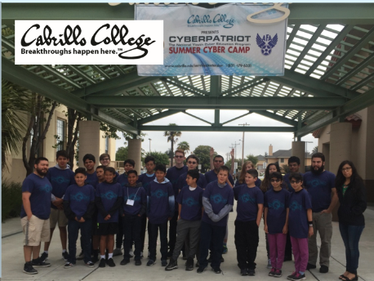
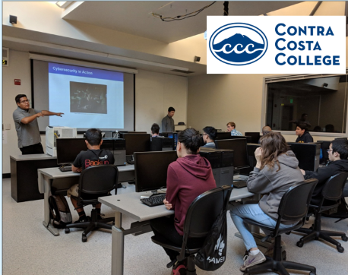
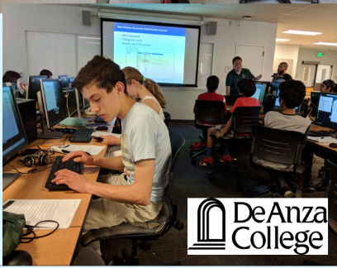
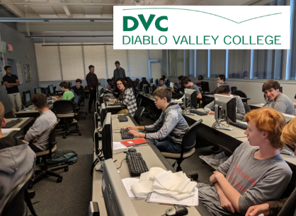

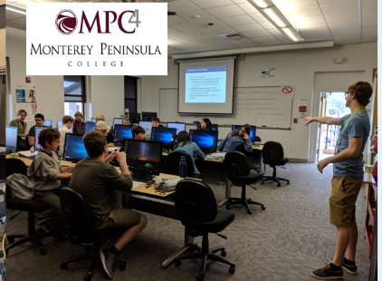

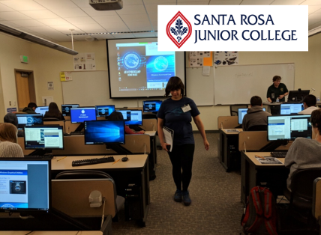
Summer CyberCamps
Notes:
We hold CyberCamps in-person at a partner Community College campus, using their computer networking lab

Slide 4
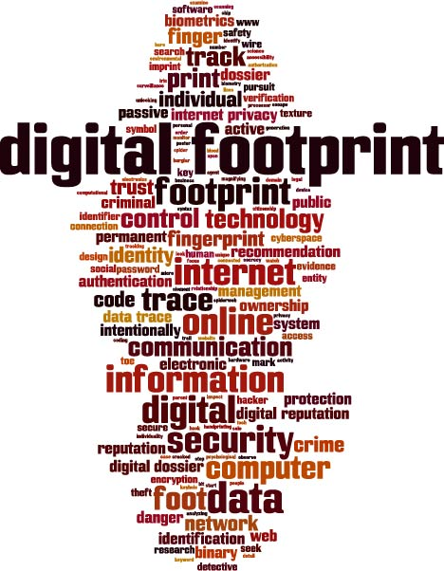


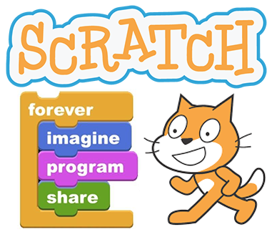

What will we cover this week?
Ethics
Networking
Notes:
We’re going to learn about:
Cyber Careers & Ethics
Digital Footprint
Basic Networking
Programming Concepts
Intro to Linux
Canvas link to Agenda document
Scratch: Creative Commons
Linux Tux: https://www.cleanpng.com/png-linux-kernel-operating-systems-free-and-open-sourc-657160/

Slide 5

Your Teaching Team
Sam Bowne
Jeremy (on Discord)
Notes:
Add teacher(s) and TAs names and photos here

Slide 6

Seven Golden Rules for Camp
Communicate respectfully
Get involved! If there is silence, take the lead
Support others when they want to take the lead
Support your fellow campers
Stay present
Technical glitches WILL happen - roll with it
Keep an open mind

Slide 7

Bay Area Cyber League
www.baycyber.net
  Competitions
  Workshops - YouTube channel
  Resources & Games

Slide 8
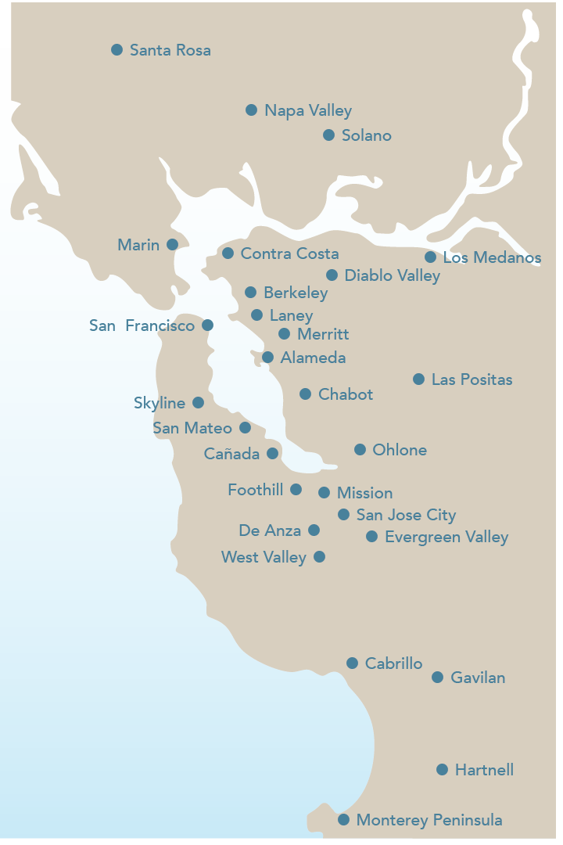
Bay Area Community College Consortium
https://baccc.org/
Notes:
Bay Area Community College Consortium: https://baccc.org/

Slide 9

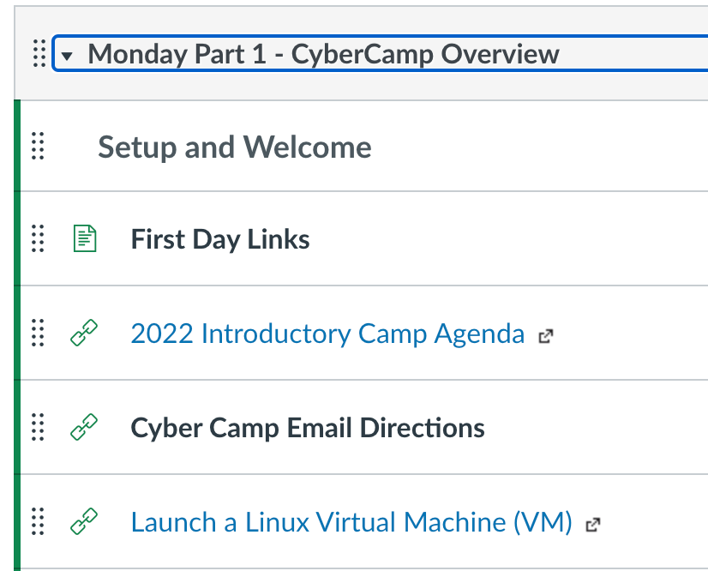
What is Canvas?
Canvas is a Learning Management System used by Bay Area Community Colleges
Canvas holds all your CyberCamp content in modules
This is where you’ll find everything you need for the entire week

Slide 10

Intro to Virtual Machines
What is a virtual machine?
Why are we using them?
Notes:
What? Virtual machines are computers that are running on someone else's computer. They don't require your resources to operate.
Why? We use them as a sandbox where you can safely make mistakes without affecting your local computer
VM image: https://www.ufsexplorer.com/img/solutions/vmdr/thumbnail.jpg

Slide 11
The Linux Virtual Machine
Go to the Monday Part 1-CyberCamp Overview module in Canvas
Click on the link titled Launch a Linux VM page and follow the instructions
Notes:
First, we will launch a Linux virtual machine. Follow the instructions in Canvas.

Slide 12

Intro to Discord
Discord is a free voice, video, and text chat app used by tens of millions of people to talk and hang out with their communities and friends
People use Discord daily for everything from video gaming, art projects and family trips to homework and socializing
Available on computer devices and smartphones
In CyberCamp, you’ll use Discord to interact with each other, the TAs, and the world outside of class or when doing breakout activities
You can text, voice/video chat, screenshare, and listen to Spotify together!
Notes:
What is Discord (For Parents and Educators): https://discord.com/safety/360044149331-What-is-Discord

Slide 13
Intro to Discord Activity
In this activity you will:
    Make a Discord account
    Join a Server
    Rename and introduce yourself
    Send and read a DM
Notes:
Add your Discord server link so campers can join your server if they haven’t already done so

Slide 14

Cisco Networking Academy

Slide 15
Cisco Networking Academy
Cisco Networking Academy is a global platform which can be used to inspire students and instructors to make their future brighter
Cisco Networking Academy puts theory and hands-on-experience into practice

Slide 16

Enroll in Cisco Packet Tracer
Notes:
CyberCamp Cisco Packet Tracer Enrollment Link: https://www.netacad.com/portal/web/self-enroll/m/course-1299820

Slide 17
Ethics
Just Because You Can,
Doesn’t Mean You Should

Slide 18
Ethics
Career not Criminal

Slide 19




What does it mean to be a hacker?
Notes:
When we hear “Hacker/Hackers”, these type of images and stories pop-into our minds
But, these are one type of hacker...commonly called…(anyone?)... a “Black Hat” hacker.
Project Zorgo image: https://www.pinterest.ca/pin/593560425866107508/
WikiLeaks image: https://wikileaks.org/
Hooded Hacker image: https://5gwirelessdanger.com/new-5g-security-threat-sparks-snooping-fears/
Anonymous image: https://www.hackread.com/american-pharmacy-association-website-hacked-defaced-by/

Slide 20
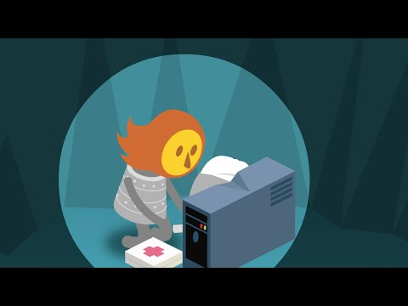
Video: The Secret Lives of Hackers
Notes:
https://youtu.be/DKzi5CYNFAg

Slide 21
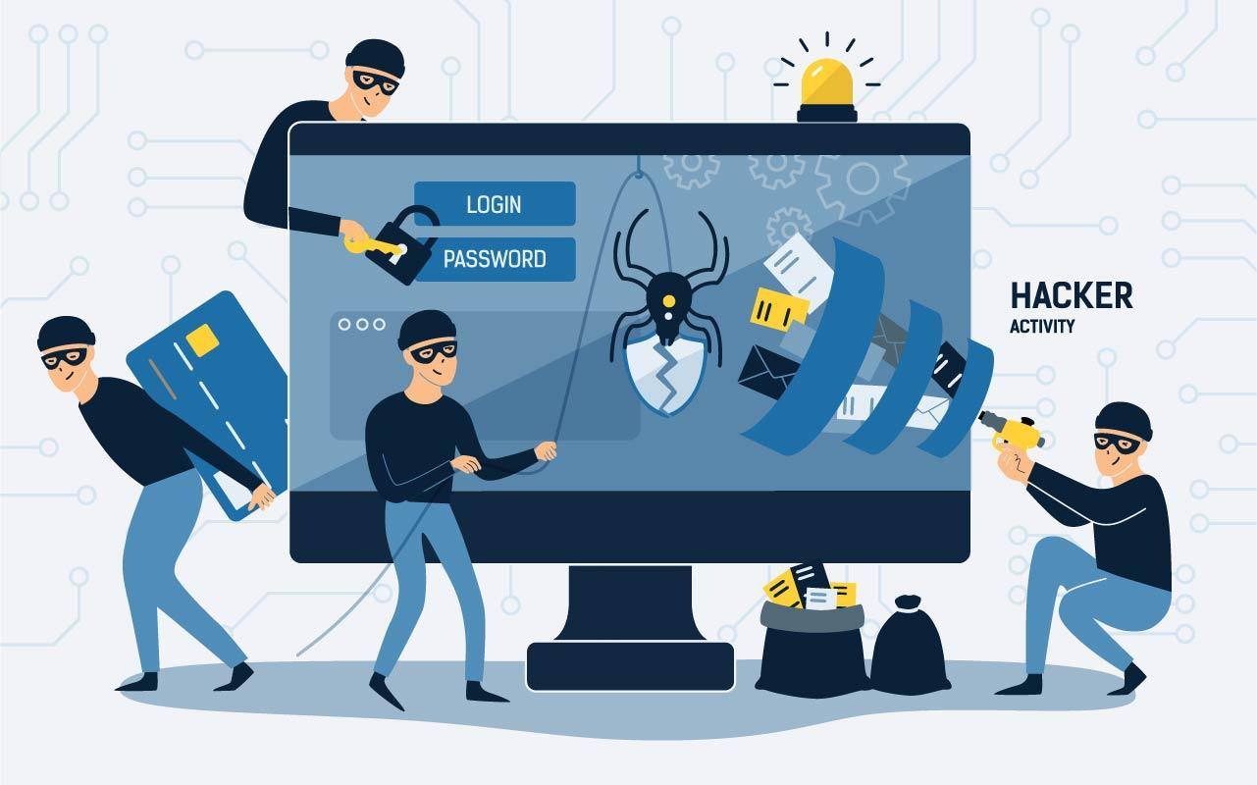
What is (Digital) Hacking?
Hacking is the process of finding vulnerabilities in a system and using these found vulnerabilities to gain access into the system

Slide 22

Types of Hackers
Now that we have a working definition of digital hacking, let’s go over the different types of hackers
Notes:
Three most common - White Hat, Grey Hat, Black Hat
What’s the difference?
Video link in Canvas = https://www.youtube.com/watch?v=E6S3-XGrZAE
More types of Hackers - 10 types of Hackers pdf in Canvas

Slide 23

White Hat Hacker
This is another name for an Ethical Hacker
They hack into a system with prior permission to find out vulnerabilities so that they can be fixed before a person with malicious intent finds them

Slide 24

Black Hat Hacker
Black hat hackers gain unauthorized access to a system and harm its operations or steal sensitive information
It’s always illegal because of its malicious intent, which includes:
  Stealing corporate data, violating privacy, damaging the system, etc

Slide 25

Grey Hat Hacker
This is a blend of white and black hat hacking
They mostly hack for fun and exploit a security weakness in a computer system or network without the owner’s permission or knowledge
Their intent is generally to bring the weakness to the attention of the owners and earn some bug bounty

Slide 26

Quiz: Identify the Hat Color
Click on the link in Canvas and take the Quiz!
Then read the section titled ‘The Different Types of Hackers’
Notes:
Trainer: Copy and rename the quiz for your camp. Add your Quiz link here and to Canvas.

Slide 27

Notes:
How do you choose? Are there rules? Are there laws? YES!

Slide 28
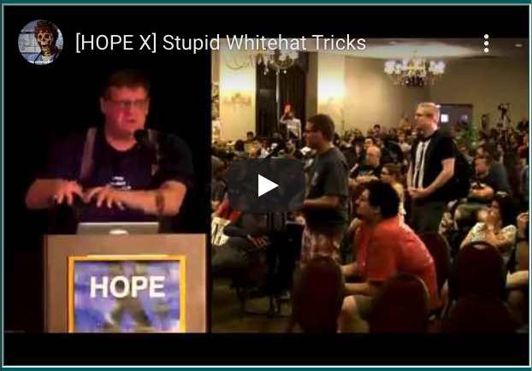
https://www.youtube.com/watch?v=8vbHtMeLIis

Slide 29
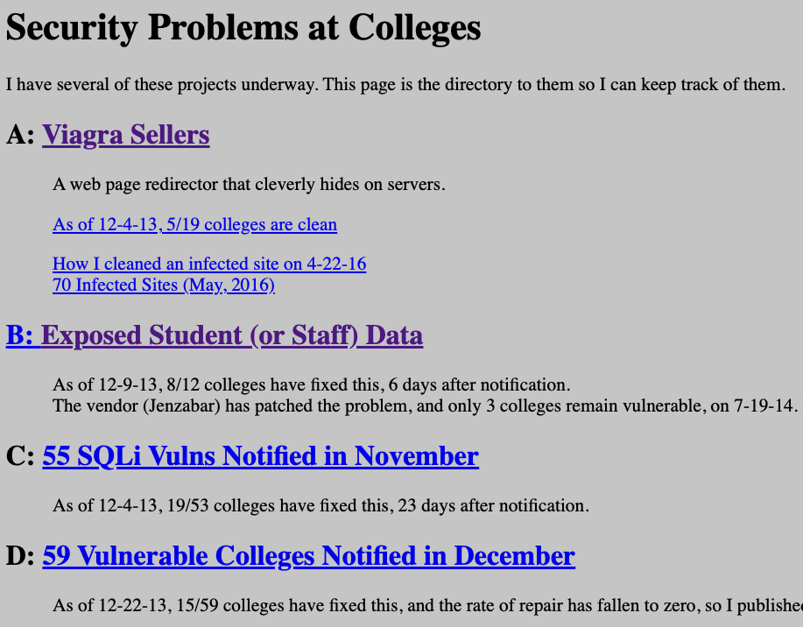
https://samsclass.info/125/proj11/college-security.htm

Slide 30
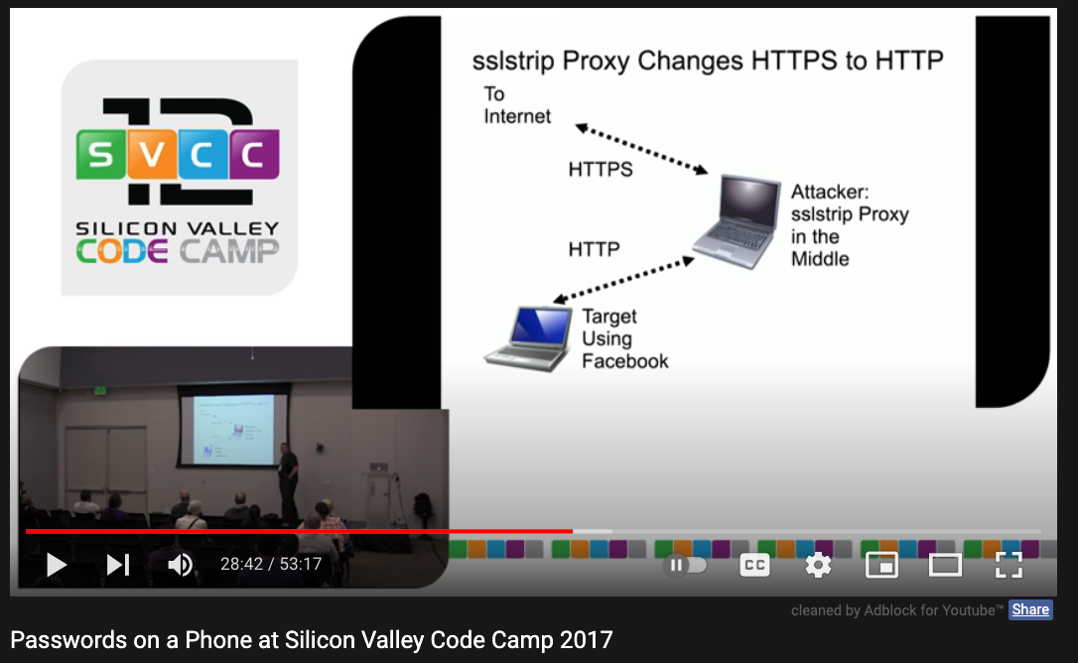
https://www.youtube.com/watch?v=V1ZADK2q4nU

Slide 31
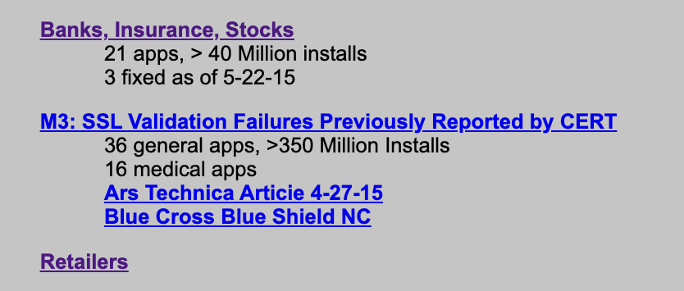
Android App Vulnerabilities

Slide 32
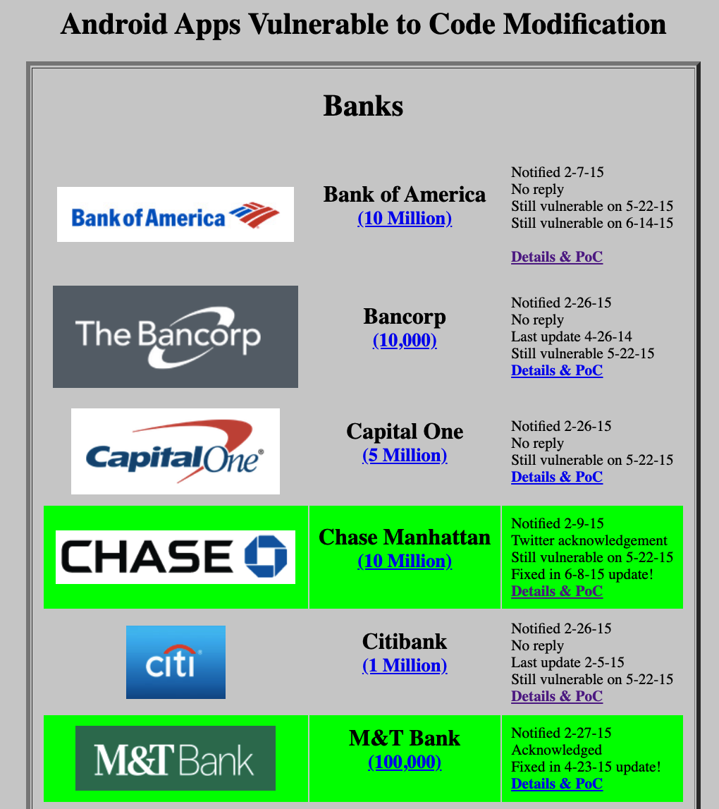

Slide 33
Ethics - Career not Criminal
10 Commandments of Computer Ethics
Thou shall NOT use a computer to harm other people
Thou shall NOT interfere with other people’s computer work
Thou shall NOT snoop around in other people’s digital files (no matter if stored on their computers, phones, or on the cloud).
Thou shall NOT use a computer to steal.
Thou shall NOT use a computer to bear false witness.
Notes:
YouTube Video link in Canvas - ask students to watch on their own in separate browser
https://www.youtube.com/watch?v=bRLY-ip5laM&list=PLVghNVK-loFtBSaJ-fPtG9DTYaEngpfMx&index=8&t=106s

Slide 34
Ethics - Career not Criminal
10 Commandments of Computer Ethics
6. Thou shall NOT copy or use proprietary software for which you have not paid.
7. Thou shall NOT use other people’s computer resources without authorization or proper compensation.
8. Thou shall NOT appropriate other people’s intellectual output.
9. Thou shall think about the social consequence of the program you are writing or the system you are designing.
10. Thou shall always use a computer in ways that ensure consideration and respect for your fellow humans.

Slide 35
College, Competitions, and Careers

Slide 36

What’s After CyberCamp?
Notes:
So, there you are...you’ve just wrapped up the summer CyberCamps...and you love it...cybersecurity is your calling now!
What’s next? What’s after CyberCamps?
Minion alert: http://www.tjohncunningham.com/having-a-real-discussion-on-recruitment-and-retention/

Slide 37
Competitions
Challenge you to think critically
Develop teamwork skills
Real-world scenarios
  BARC 2019 - Small Business Consultation
  BARC 2020 - Bug Bounty
  BARC 2021 - Maritime Warfare
Notes:
Many competitions have Scholarship Cash & Gadget Prizes
At the Bay Area Regional Competitions (BARC) - our boss is fond of drones/gadgets for prizes...and trophies (of course).
In 2019, teams of students were given a small business computer set-up to analyze, make improvements, and then justify their choices to a panel of volunteer judges (representing local technical businesses/organizations). Please watch the short video - link is in Canvas.

Slide 38






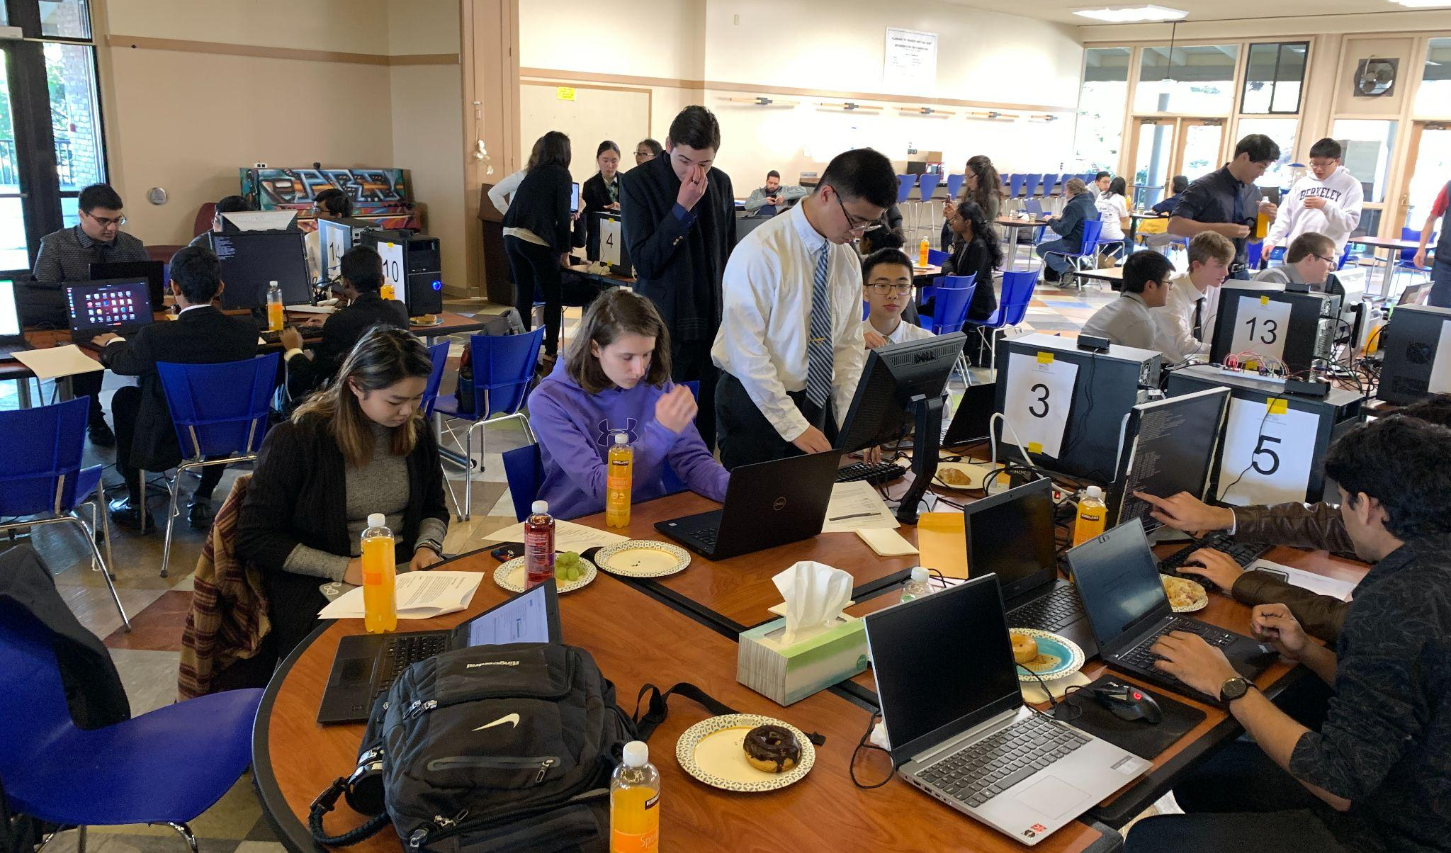
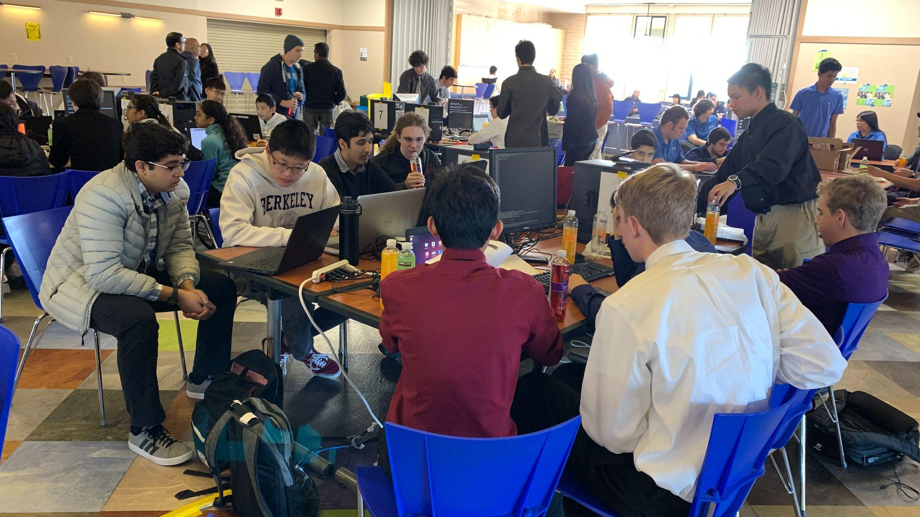


Cyber Competitions
Fall & Spring
Notes:
Year-Round Cybersecurity Competitions can be next...video links in Canvas. (Pick 2 videos to watch)
Holiday Hack Challenge: https://www.sans.org/mlp/holiday-hack-challenge/
National Cyber League: https://nationalcyberleague.org/
CyberStart: https://cyberstart.com/
CyberPatriot: https://www.uscyberpatriot.org/
picoCTF: https://picoctf.org/
CTFTime: https://ctftime.org/
WRCCDC: https://wrccdc.org/
CyberForce: https://cyberforce.energy.gov/

Slide 39
Competitions Exploration
When exploring the various competitions, here are some things to look for:
  Who is the competition geared towards?
  What time of year does it occur?
  Is it in-person or online?
  What skill levels are recommended?
  What are the prizes?
The FAQs will often answer most of these questions

Slide 40

Additional Training & Resources
Cisco NetAcademy
  Intro to Cybersecurity
  Linux Essentials
  Network Essentials
  Intro to Packet Tracer

Slide 41

An Introduction to Cybersecurity Careers
Notes:
Video: https://youtu.be/-AkuKKJ8dN0

Slide 42
Career Pathways
Exploring Career Opportunities
  Cyberseek.org
  Cyber.org
Freelance / Independent Contractors
  CyberCamp TAs
  Bug Bounty Hunters
Notes:
Cybersecurity is a great career pathway to pursue - there are a lot of difference opportunities
CyberSeek.Org - “Explore Heat Map” to see current local demand; “Explore Career Pathway” to see different jobs and pay range
Lots of opportunities as “Freelance” or “Independent Contractor” - as full time or side-hustle
Your CyberCamp TAs are “Independent Contractors”
Please view Hacking Careers & Bug Bounty Videos

Slide 43
Career Pathway - High School
High School to Community College (CC) - Early College Credit
  Dual Enrollment
    Taught at CC or at High School location
    Taught by CC qualified instructors
  Articulation
    High School course deemed equivalent to CC course
    Credit request after course completion
Notes:
Earn Early College Credit - You can start taking Community College classes (Cybersecurity classes) while still in High School
Check with your High School CTE Counselor/Coordinator for available classes and how to register

Slide 44



UC-CSU College/Scholarship Applications
University of California
  Personal Insight Questions
California State University
  Extracurricular Program Hours of Participation & Leadership
Scholarships
  Extracurricular Training/Activities
Notes:
UC Personal Insight Questions - website link in Canvas https://admission.universityofcalifornia.edu/how-to-apply/applying-as-a-freshman/personal-insight-questions.html
CSU Extra Curricular Programs Hours of Participation & Leadership: https://help.liaisonedu.com/Cal_State_Apply_Applicant_Help_Center/Filling_Out_Your_Cal_State_Apply_Application/Cal_State_Apply_Supporting_Information/4_Educational_Programs_and_Work_Experience
Scholarships Extra Curricular

Slide 45







Career Pathway -
Industry Certifications
Notes:
In the Cybersecurity field, industry certifications are highly valued....equally if not more than academic degrees
You can start learning and earning industry certifications...right away...now...well, wait until after camp please.
Google Cloud: https://support.google.com/cloud-certification/answer/9750149?hl=en
AWS: https://aws.amazon.com/certification/certification-digital-badges/
CompTIA A+: https://www.comptia.org/certifications/a
CompTIA Security+: https://www.comptia.org/certifications/security
CompTIA Network+: https://www.comptia.org/certifications/network
Cisco CCNA: https://www.cisco.com/c/en/us/training-events/training-certifications/certifications/associate/ccna.html
Microsoft Certified: https://docs.microsoft.com/en-us/learn/certifications/

Slide 46



Career Pathway - Community College
Associate Degree, Certificate of Achievement, Skills Certificate
Transfer Degree
Notes:
For most cybersecurity jobs (in the Bay Area) - you will need an Associate Degree/Bachelors Degree for entry-level
Most UC/CSU Bachelors Degree programs are Computer Science/Engineering focused - Cybersecurity offered as a minor
Community Colleges: https://www.cccco.edu/
CSU: https://www.calstate.edu/
UC: https://www.universityofcalifornia.edu/
WGU: https://www.wgu.edu/
National: https://www.nu.edu/
More colleges starting cybersecurity focused programs - Western Governors University & National University have Cybersecurity BS/BA

Slide 47
Introduction to Artificial Intelligence (AI)
Machine Learning, Neural Networks,
and Artificial Intelligence
Source: techgirlz.org

Slide 48

How AI Works: Intro to AI
Source: Code.org
Notes:
https://www.youtube.com/watch?v=Ok-xpKjKp2g

Slide 49
Machine Learning
A Different Way to Program

Slide 50
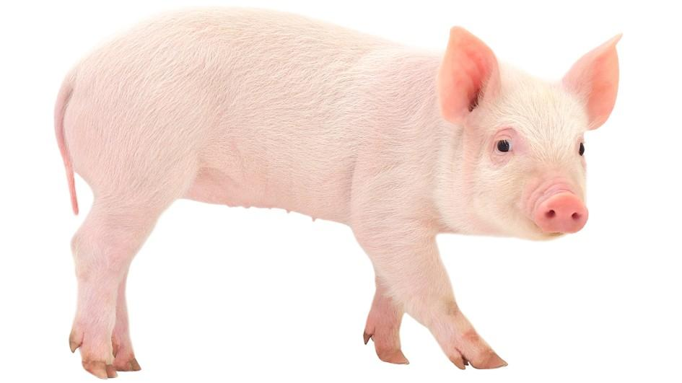
What is a pig?
Source: techgirlz.org
Notes:
Ask the students: If you were trying to teach a person rules for what a pig looks like, what would your rules be? In other words, if you were writing a program that took a picture as input and you had to make up rules to determine if the image was a pig, what would your rules be?
Examples: Pink, snout, four legs, pointy ears, etc.
You can even start to write them down on a whiteboard or chalkboard if you have that available.

Slide 51
Traditional Programming
Traditional Code for
“Is this picture a pig?”
  if (isPink(picture) and hasTail(picture) and hasPointedEars(picture) and hasFourLegs(picture) and …)
  print “Yes!”
  else
  print “No!”
Rules for
“Is this picture a pig?”
  Is it pink?
  Does it have a tail?
  Pointed ears?
  Four legs?
  And so on...
Notes:
How might you write those rules into code?
Think of unique features/identifiers.

Slide 52
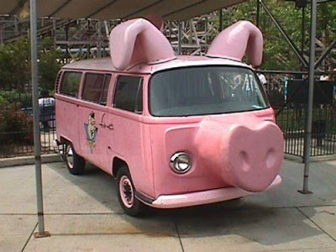
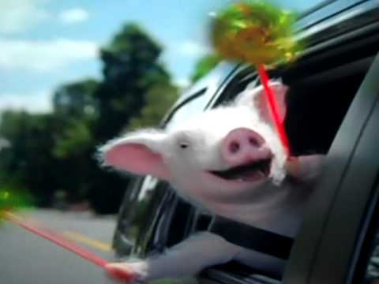
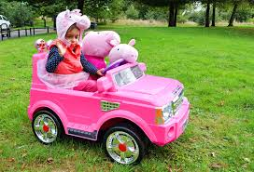
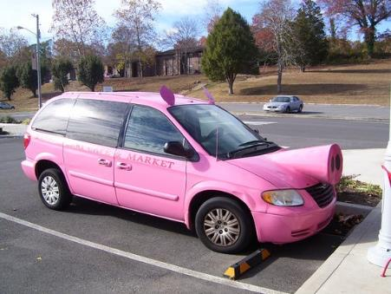
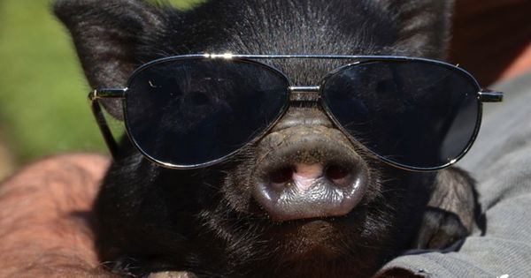
Pig or not?
Source: techgirlz.org
Notes:
Ask the students: What about the weird cases? Would your rules call some of these pictures pigs when they aren’t, or would they say some of the pictures that really are pigs are NOT pigs?
Our brains are able to figure out by looking at these pictures which things are actually pigs and which things aren’t real pigs (even though they have some of the same “features” as pigs).

Slide 53

How do you decide the rules?
Source: techgirlz.org
Notes:
Ask the students: Now having seen some example pictures, can you capture all possible cases by figuring out what every single rule is? How many rules do you think there would be to be able to correctly identify lots of pictures as pigs or not pigs? How do you decide how many rules are enough?
Examples: Pink, snout, four legs, pointy ears, etc.
You can even start to write them down on a whiteboard or chalkboard if you have that available.

Slide 54
You don’t! You let the computer learn and apply the rules.
Machine Learning
Source: techgirlz.org
Notes:
Examples: Pink, snout, four legs, pointy ears, etc.
You can even start to write them down on a whiteboard or chalkboard if you have that available.

Slide 55
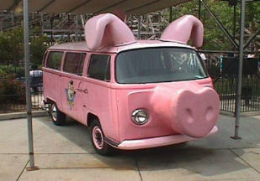
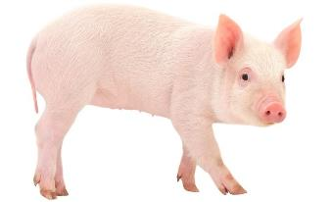

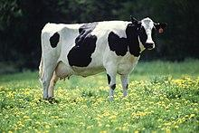
Machine Learning
A machine learning method takes a bunch of data and “learns” from it!
Machine
Learning
Method
Data
Label: Not a pig
Label: Pig
Machine’s rules for determining whether or not an image is a pig
Label: Pig
Label: Not a pig
Notes:
Note that the data consists of both pictures and labels. We KNOW the answer for these pictures, and we’re going to use the known answers to build our machine learning method. The more data it has to learn on, the better!

Slide 56
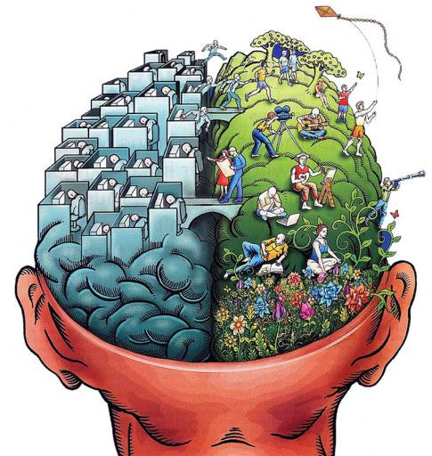
What’s the difference between memorizing and learning?
Source: techgirlz.org
Notes:
Point out to students the difference between memorizing vs. learning how to do something new with the aid of collective experience. We don’t want our machine to just be able to memorize what it has seen before. We want to be able to give it something it’s NEVER seen before and have it still be able to do the job.
Examples: Pink, snout, four legs, pointy ears, etc.
You can even start to write them down on a whiteboard or chalkboard if you have that available.

Slide 57
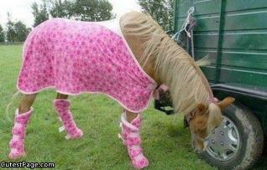
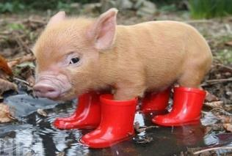
Did it “Learn”?
Training Data
The data we give to the machine learning method to learn from
Label: Not a pig
Label: Pig
Label: Pig
Label: Not a pig
Testing Data
The data we hold out and use to check to see if the method actually learned something!
Label: Not a pig
Label: Pig
Source: techgirlz.org
Notes:
How do we test whether a machine has actually learned something? Did it just memorize what you taught it, or did it actually learn the underlying concept? For example, in math class you might learn the quadratic formula and how to use it, but can you identify every situation in which you would apply it? This takes lots of experience, gained by seeing lots of problems, both that DO use the quadratic formula and those that DO NOT use it.
Here, we separate our labeled data into two sets, training and testing. We use the training data to build the machine learning method and then we use the testing data to check to see if it actually learned something. If it does really well on the training data and really badly on the testing data, that means it just memorized the training data. But, if it does well on both, then that means it learned something!
Is human learning hard? Is it hard for a machine to learn? We are trying to make it easier for machines to learn the way that humans do.

Slide 58


Why does Machine Learning Work?
Powerful Computers
Lots of Data
350 million new photos to Facebook every day
300 hours of video uploaded to YouTube every minute
500 million Tweets every day
Computers are faster and bigger than ever!
Source: techgirlz.org
Notes:
A lot of machine learning techniques have been around for 50+ years, but it’s only in the last couple of years that many of them have been able to work really, really well. A combination of data and computer power has enabled machine learning to work so well. What are the labels for Facebook or YouTube (descriptions and tagging provided by the uploader, comments, etc.)

Slide 59
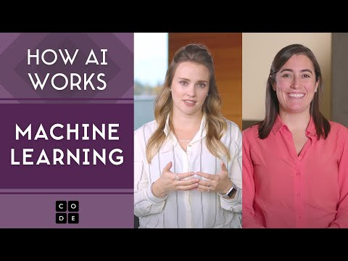
How AI Works: Machine Learning
Source: Code.org
Notes:
Video: https://youtu.be/OeU5m6vRyCk

Slide 60

Machine Learning Activity: AI for Oceans
Source: Code.org
Notes:
Hour of Code Activity. https://studio.code.org/s/oceans/lessons/1/levels/1

Slide 61
Bias in AI
Opinions Count

Slide 62
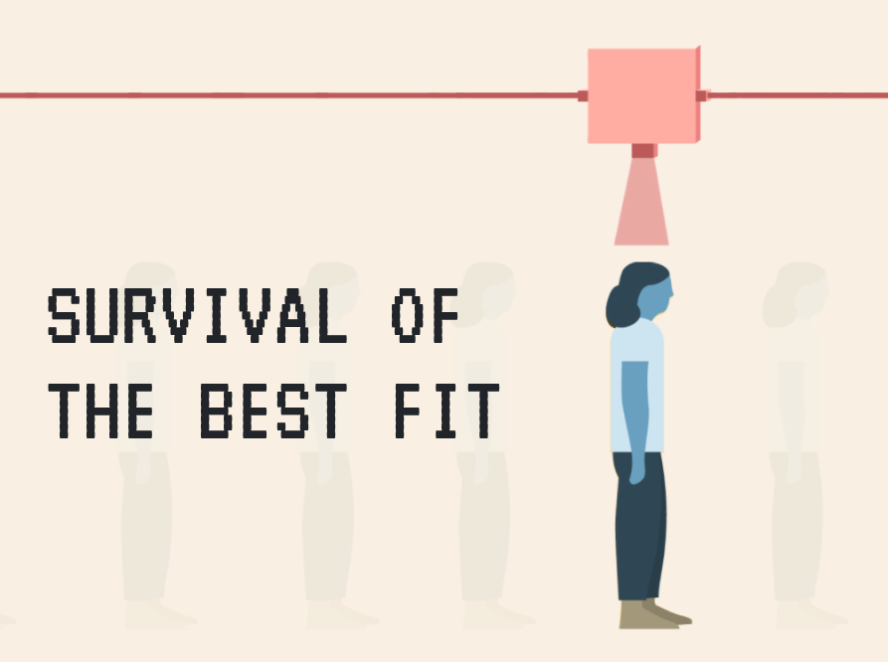
Bias in AI Activity
Notes:
https://www.survivalofthebestfit.com/

Slide 63
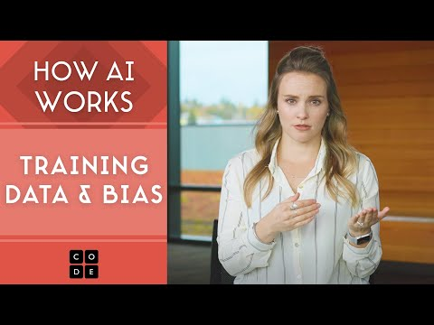
How AI Works: Training Data & Bias
Source: techgirlz.org
Notes:
Video: https://youtu.be/x2mRoFNm22g

Slide 64
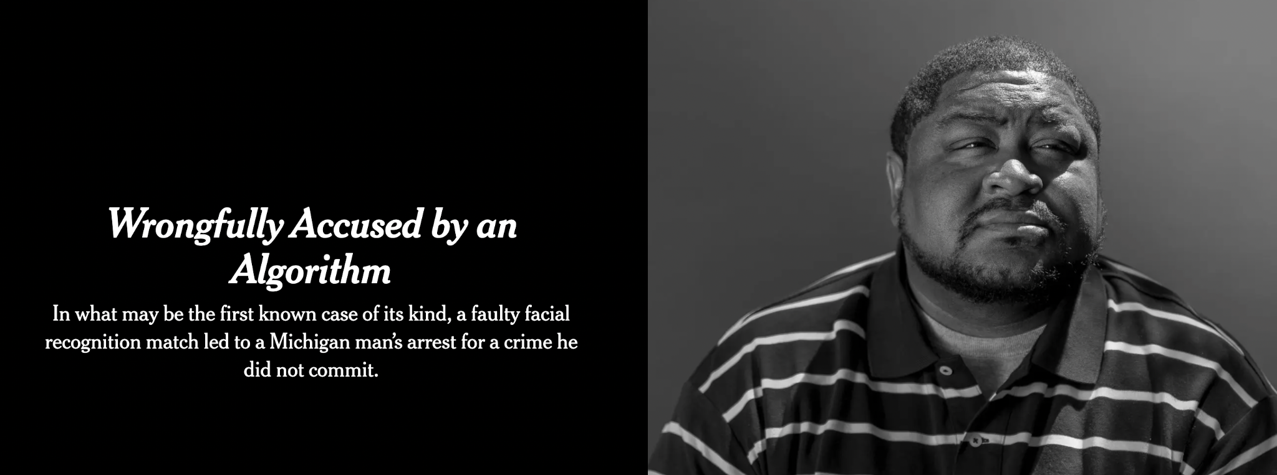
Article: Wrongfully Accused by an Algorithm
Source: New York Times
Notes:
Article: https://www.nytimes.com/2020/06/24/technology/facial-recognition-arrest.html

Slide 65
Neural Networks

Slide 66

How AI Works: Neural Networks
Source: Code.org
Notes:
https://youtu.be/JrXazCEACVo

Slide 67
More About Neural Networks
A neural network is a mathematical system that can analyze data and pinpoint patterns
If you feed thousands of cat photos into a neural network, it can learn to recognize the patterns that define what a “cat” looks like
The first neural networks were built in the 1950s, but weren’t useful until the 2010’s
For decades, neural networks had two significant limitations: not enough data and not enough computer processing power
The internet gave us reams of data, and eventually scientists had enough computing power to crunch through it all

Slide 68

Neural Networks
Think about data as lists of numbers -- even pictures
Machine Learning Algorithm Examples:
  K-Nearest Neighbors (KNN)
  Artificial Neural Networks (ANN)
Source: techgirlz.org
Notes:
Now that we’ve seen machine learning in action, let’s learn about how it actually works. Most machine learning methods treat all of their input data as lists of numbers. Even pictures are lists of numbers (the different levels of red, green, and blue in each pixel are numbers that describe the picture).
We’re going to learn about how two different machine learning methods work: K-Nearest Neighbors and Artificial Neural Networks

Slide 69
Neural Networks
K-Nearest Neighbors Algorithm

Slide 70
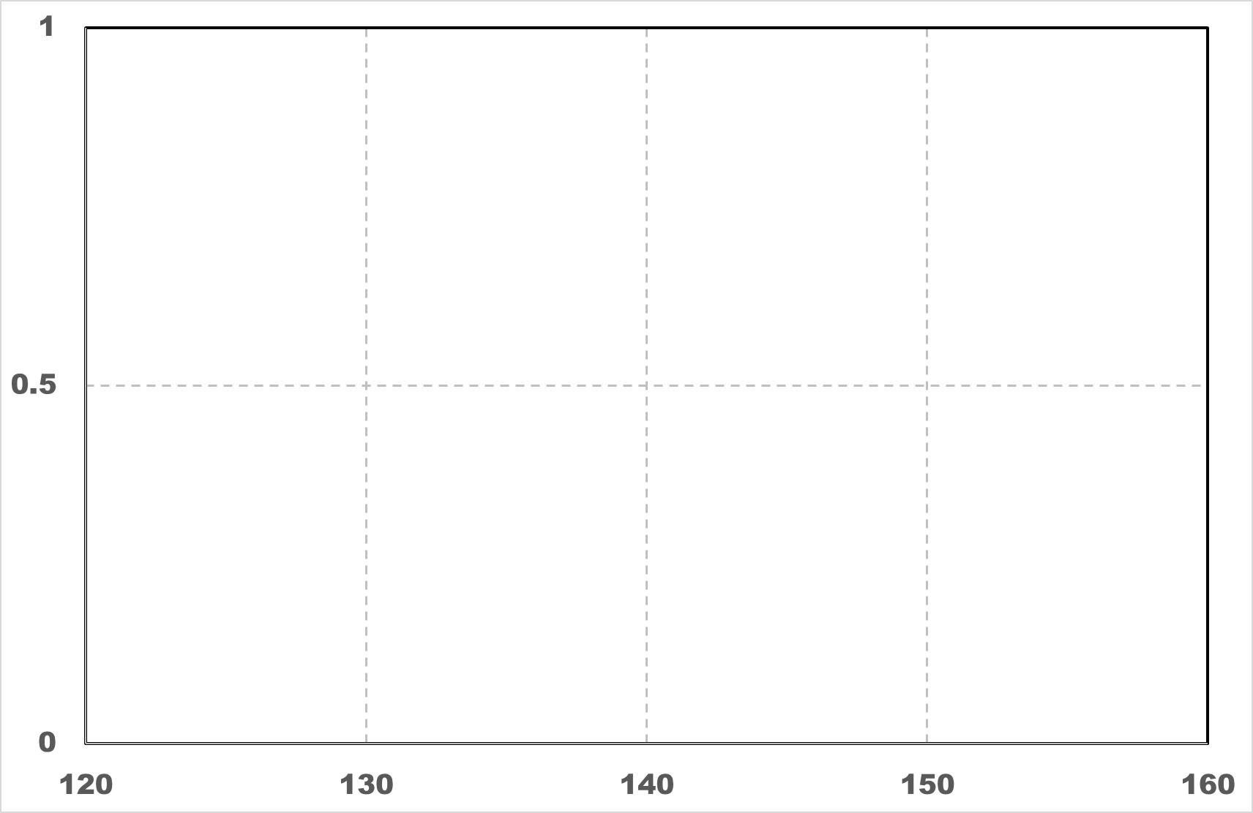
Fruit Data: Apples vs. Oranges
Smoothness
Orange
Weight = 150g
Smooth = 0.5
Apple
Weight = 130g
Smooth = 0.5
Weight (grams)
Source: techgirlz.org
Notes:
Suppose you have a bunch of data points of different classes and you plot them out into space. Let's assume the red one are apples and the orange squares are oranges. X-axis is weight and y is smoothness of the surface. Here are the data (Explain how to read the graph using the two labeled points).

Slide 71
K-nearest neighbors (KNN)
Which fruit?
3 neighbors
Source: techgirlz.org
Notes:
Animation to show classification by looking at the three closest neighbors.

Slide 72
K-nearest neighbors (KNN)
Check the 3 nearest neighbors
3 neighbors
Source: techgirlz.org

Slide 73
K-nearest neighbors (KNN)
Classify as Apple
Which fruit?
3 neighbors
Source: techgirlz.org
Notes:
It’s classified as an apple because more of its three neighbors were apples and less were oranges (2 vs. 1).

Slide 74
K-nearest neighbors (KNN)
1 neighbor
Source: techgirlz.org
Notes:
Ask: What if you only looked at one neighbor, instead of three?

Slide 75
K-nearest neighbors (KNN)
Check nearest neighbors
1 neighbor
Source: techgirlz.org
Notes:
Ask: Based on its one neighbor, do you think the new data point should be an apple or an orange?

Slide 76
K-nearest neighbors (KNN)
Classify as Orange
1 neighbor
Source: techgirlz.org
Notes:
This time it’s an orange, because its one neighbor is an orange. So different numbers for k will work differently on some data sets.

Slide 77
Neural Networks
Artificial Neural Networks Algorithm

Slide 78
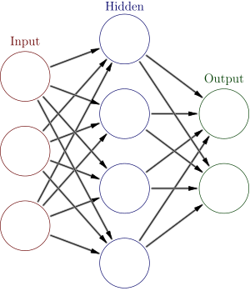
Artificial Neural Networks
30
2
50
-1
1
70
Source: techgirlz.org
Notes:
What does an artificial neural network look like? It has neurons (the circles) and synapses (the edges between them). The simple neural networks we’re looking at have input neurons, where data comes in, hidden neurons, where internal calculations are done, and output neurons, where the answer is read from. Each of the synapses has a fixed number associated with it (a weight value), while the neurons do all of the calculations based on the current data instance.

Slide 79
Artificial Neural Networks
30
2
50
-1
30*2
1
70
Source: techgirlz.org
Notes:
The incoming data numbers are multiplied by the numbers on the synapses and added up at the hidden neuron.

Slide 80
Artificial Neural Networks
30
2
50
-1
30*2 + 50*(-1)
1
70
Source: techgirlz.org
Notes:
The incoming data numbers are multiplied by the numbers on the synapses and added up at the hidden neuron.

Slide 81
Artificial Neural Networks
30
2
if number > 0
send number
else
send 0
50
-1
80
30*2 + 50*(-1) +70*1 = 80
1
70
Source: techgirlz.org
Notes:
The incoming data numbers are multiplied by the numbers on the synapses and added up at the hidden neuron. A simple function is applied at the end to get the number that comes out of that neuron.

Slide 82
Artificial Neural Networks
-30
2
if number > 0
send number
else
send 0
30
-1
0
-30*2 + 30*(-1) +70*1
= -20
1
70
Source: techgirlz.org
Notes:
We can change the neuron with the data, but the synapse values stay the same!

Slide 83
Artificial Neural Networks
-30
2
if number > 0
send number
else
send 0
30
-1
0
-30*2 + 30*(-1) +70*1
= -20
1
70
Weights
Source: techgirlz.org
Notes:
We can change the neuron with the data, but the synapse values stay the same!

Slide 84
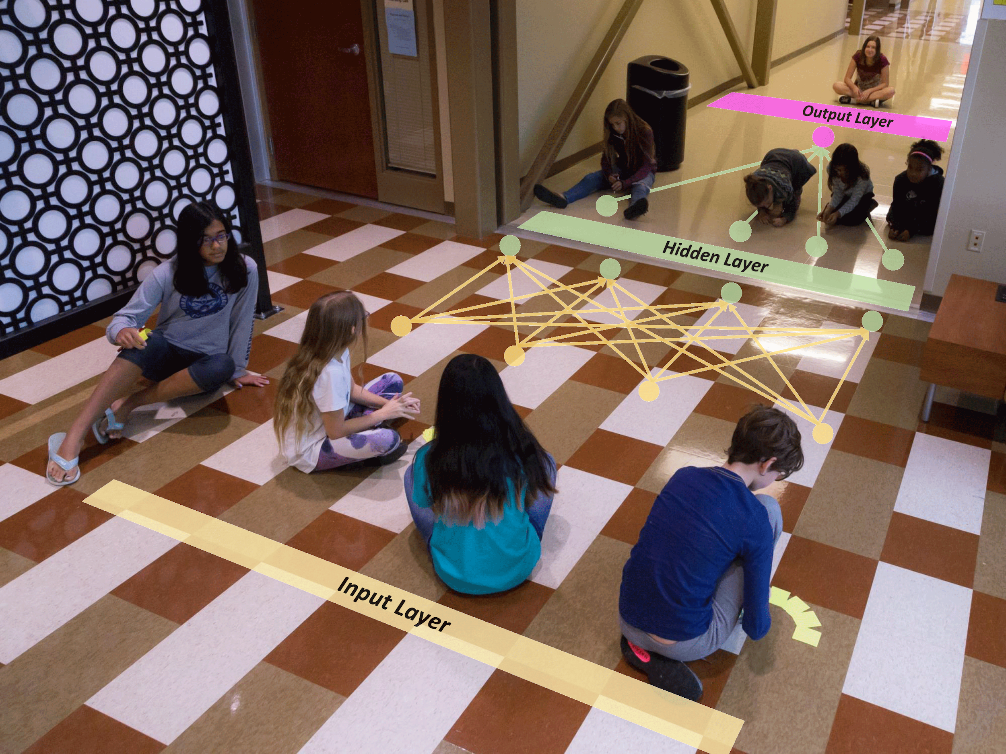
Unplugged Activity
Human Neural Network Game
Source: Techgirlz. By: Catherine Schuman, Steven Young, Thomas Proffen, Dasha Herrmannova
Notes:
https://docs.google.com/document/d/1gvvrAHPtxO2RixBx1qXoK3z-eQg93X5IMcL4E2aaxaM/edit?usp=sharing

Slide 85

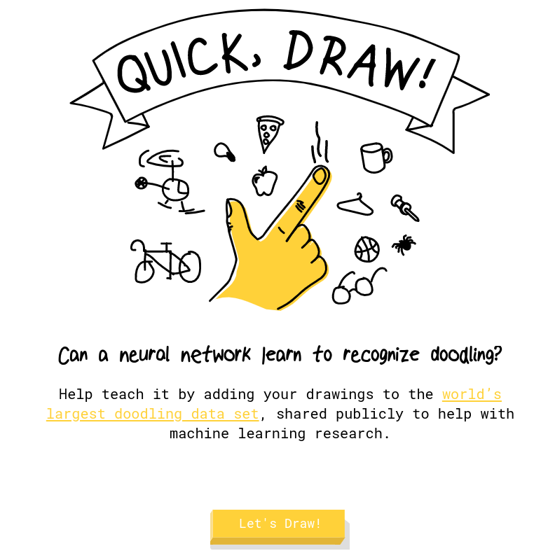
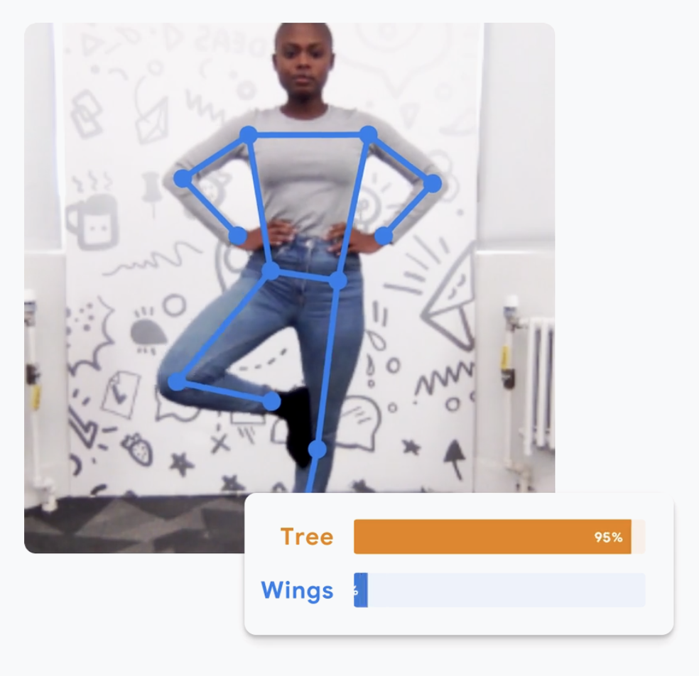
AI Powered Experiments
Notes:
https://quickdraw.withgoogle.com/
https://experiments.withgoogle.com/freddiemeter
https://experiments.withgoogle.com/teachable-machine

Slide 86
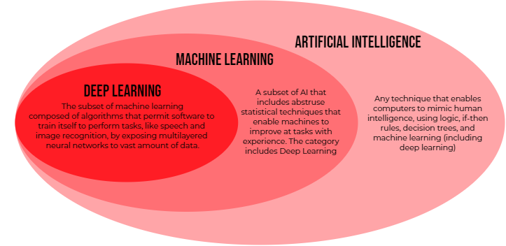
Source: Imanol Goicoechea

Slide 87
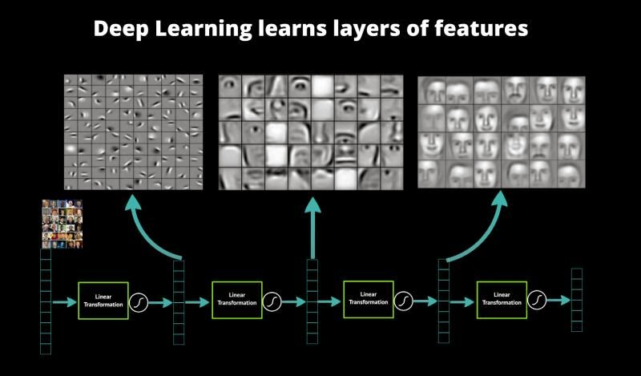
Notes:
More complex neural networks used in “deep learning” have many layers. Different layers learn different levels of complexity. For example, if the neural network were trying to recognize faces, the first layers may look for different lines or edges, while the next layer combines the edges/lines to look for things like noses or ears or eyes, and then the last layer combines the noses, ears, eyes, etc., to build full faces.

Slide 88
AI In Our World

Slide 89
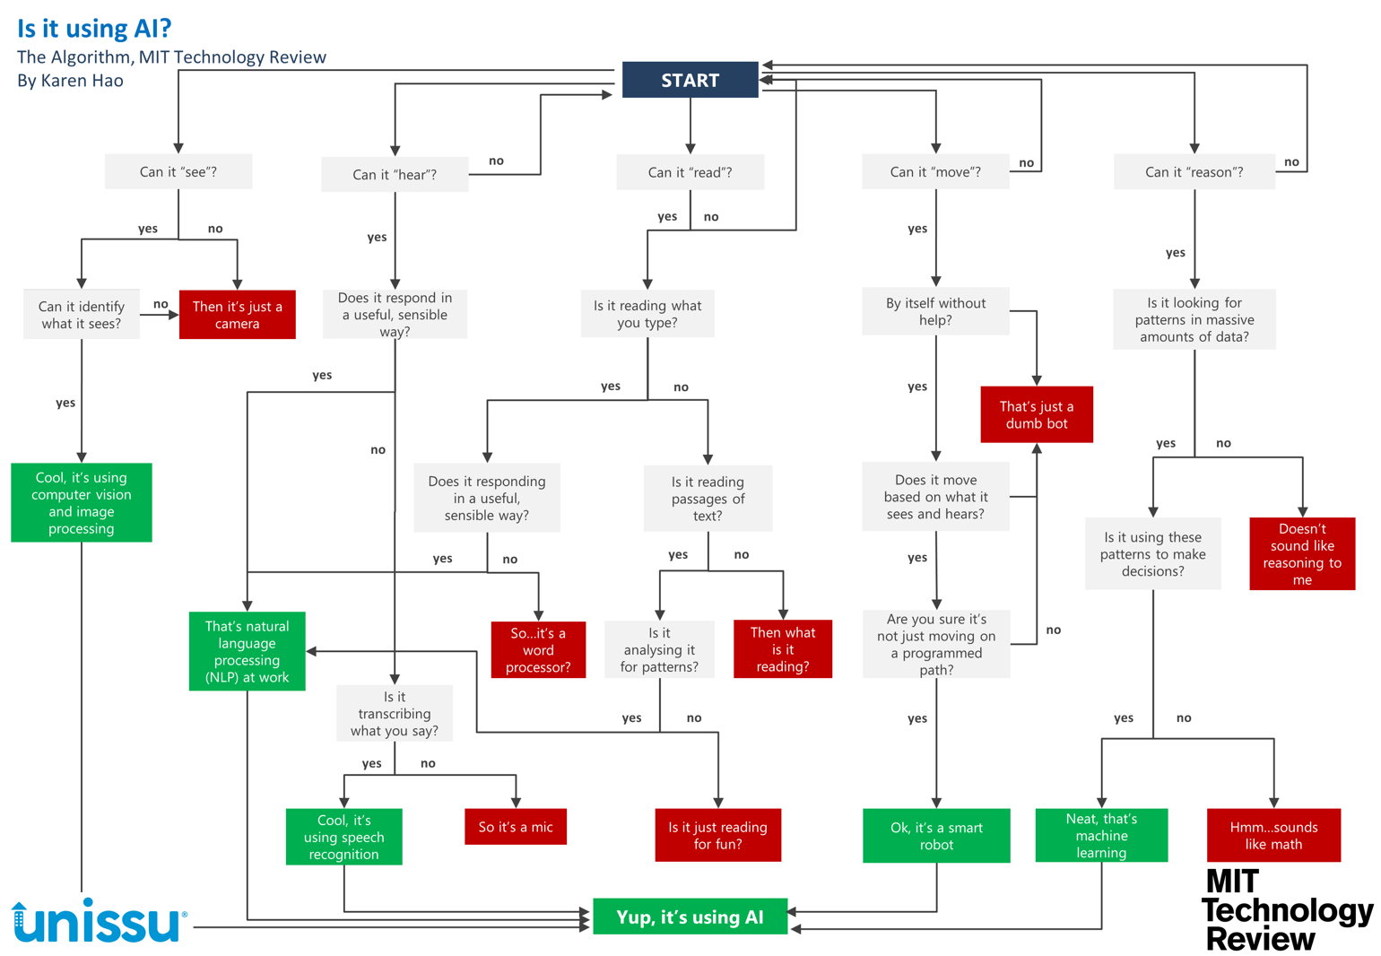
Notes:
Is it using AI? Flowchart: https://docs.google.com/document/d/1knE84oDyTgVJH-ibcy0buH2_uoR7tufg5hzh-s-0BBw/edit?usp=sharing

Slide 90
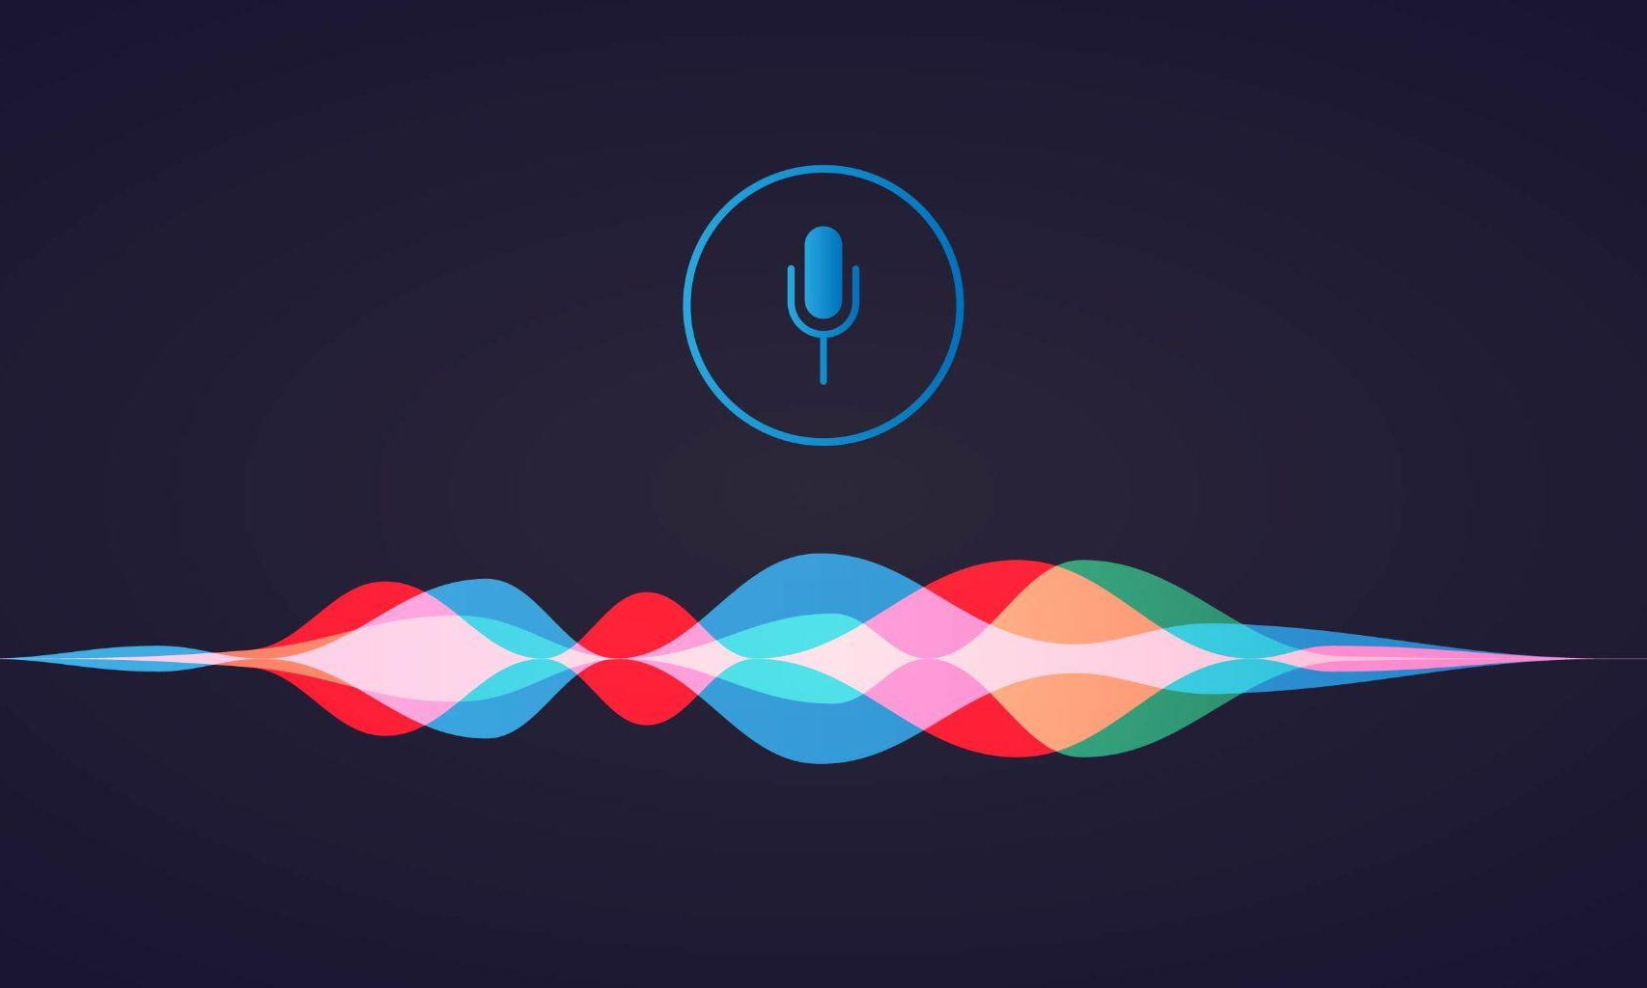
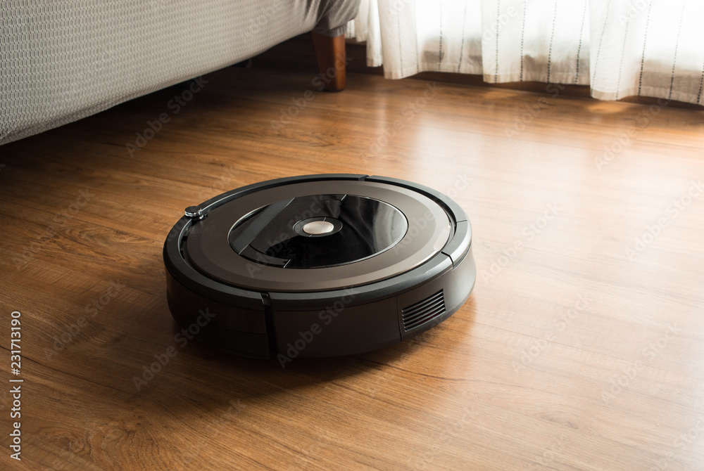

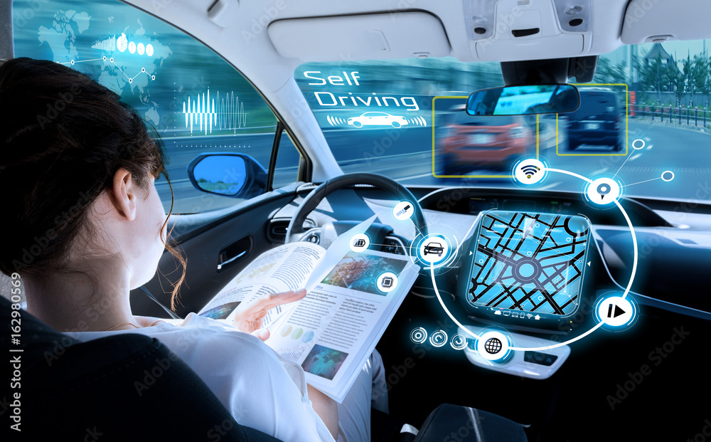
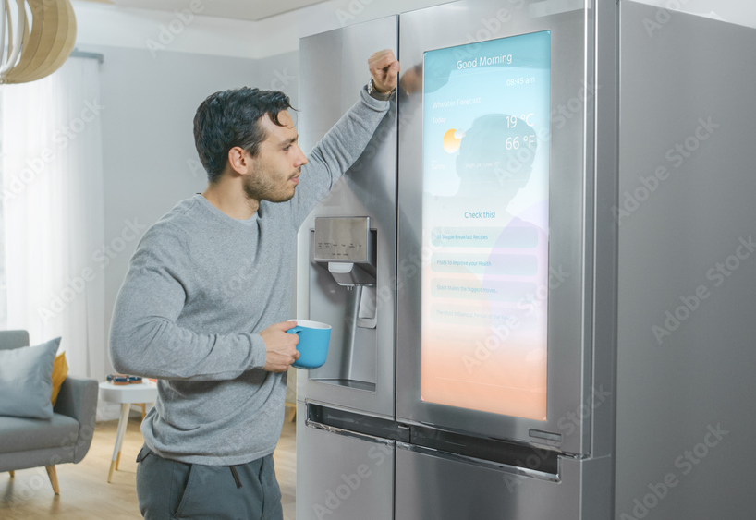
Uses AI Activity - Yes or No?
Notes:
Use the flow chart from p. 43 to identify
Google: https://about.google/brand-resource-center/brand-elements/#google-logo

Slide 91
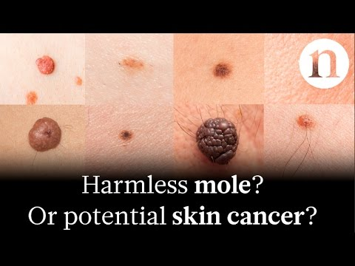

AI for Good Videos
AI in Dermatology
AI for the Visually Impaired
Notes:
Benign or Cancerous: https://youtu.be/IvmLEq9piJ4
Seeing AI: https://youtu.be/bqeQByqf_f8

Slide 92

AI in our Lives Group Exploration
Each member of your group should choose an area of interest and research how Artificial Intelligence is being used to improve it.
Create a 5 minute presentation (one slide per group member) you will show to the class.

Slide 93
Take-Aways
Rather than hard coding all of the rules about what you’re trying to do into normal code, machine learning codes learn from data to build the rules!
We rely upon machine learning applications every day
Pictures, videos, music, etc., can all be represented as lists of numbers, so similar machine learning approaches will work for them
AI is everywhere and will increasingly become part of our lives.
  We need to be careful about the data used for training a machine to become artificially intelligent so that we don’t introduce bias into its decision making

Slide 94
Monday Wrap-Up & Reminders
Please take End of Day Survey

Slide 95
Cybersecurity Overview
Ethics & Opportunities

